Slide 1
Ferrari: A Personalized Federated Learning Framework for Heterogeneous Edge Clients
Zhiwei Yao, Jianchun Liu, Hongli Xu, Lun Wang, Chen Qian, Yunming Liao
IEEE TRANSACTIONS ON MOBILE COMPUTING (Oct. 2024)
IF: 7.7
Faranak Solat
December 2024

Slide 2
A brief preview on Abstract
Training the local models with pseudo-labeling
Insufficient labeled data problem
Federated Semi-Supervised Learning (FSSL)
Focusing heterogenous clients (non-IID scenario)
Training Performance (e.g., efficiency and accuracy)
Issue
Solve
The number of model migration
The quality of pseudo-labels
Impact on

Slide 3
Introduction - Motivation
By 2025, there will be 75.44 billion Internet of Things (IoT) devices
These devices will generate a massive amount of data every year
The modern cloud-centric applications can collect the generated distributed data from the devices
Transferring this huge amount of data to Parameter Server (PS) is communication costly and has privacy-related issues
It motivates to use applications of Federated Learning (FL)

Slide 4
Introduction - Motivation
In practical scenarios, due to the high labeling costs and lack of expertise
There are always insufficient annotated (or labeled) data on the edge clients resulting poor performance on FL
However, training the large amount of unlabeled non-IID data has high computation and communication cost on clients
It motivated to use Federated Semi-Supervised Learning (FSSL)
It motivated to use Personalized Federated Learning (PFL)

Slide 5
Introduction - Motivation
However, the clients with labeled data still struggle to obtain component personalized models due to insufficient knowledge of local data distribution
It motivated to focus on the seeking labeling assistance from similar models for better personalization

Slide 6
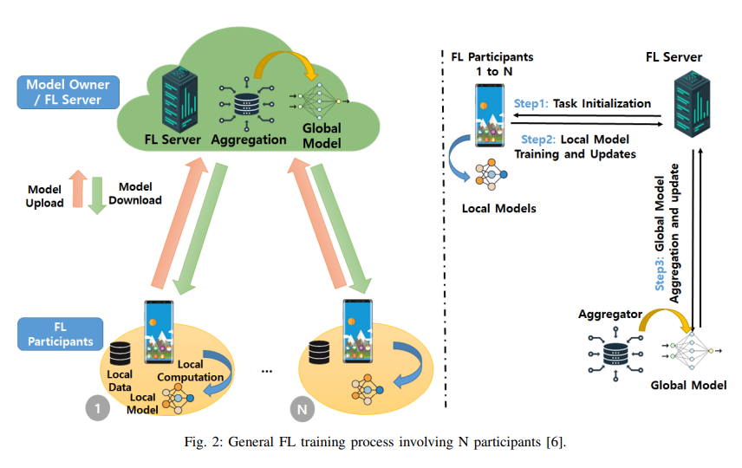
Introduction - Problem Statements: Federated Learning (FL)
Emerging to address the above privacy challenge is FL proposed by Google in 2016.
Federated Learning (FL)
Including 3 steps:
Task initialization
Local model training and update
Global model aggregation and update
<General FL training process involving $N$ participants>

Slide 7
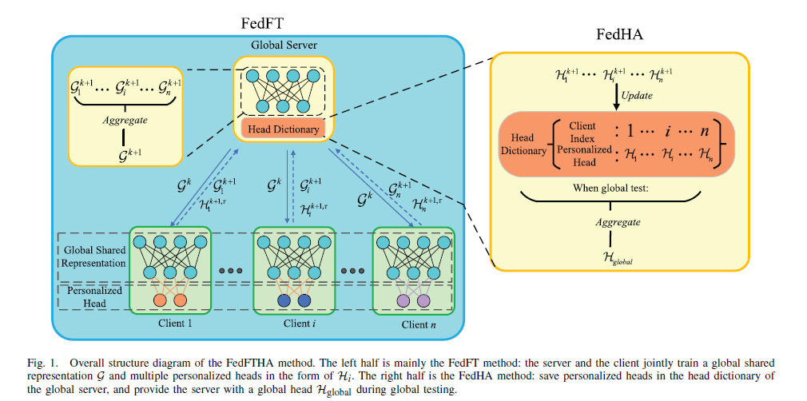
Introduction – Problem Statements: Personalized Federated Learning (PFL)

Slide 8
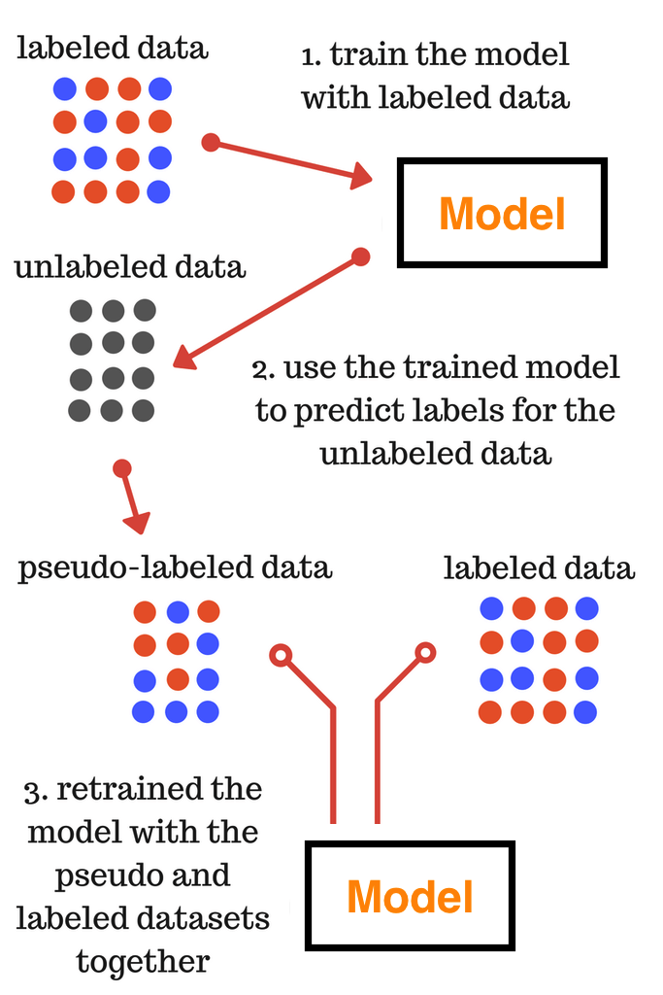
Introduction – Problem Statements: Semi-Supervised Learning (SSL)
Semi-Supervised Learning (SSL): To tackle label scarcity by leveraging the unlabeled data
Two primary categories:
In Pseudo-labeling based algorithms, instead of manually labeling the unlabeled data, we give approximate labels on the basis of the labelled data.
Consistency regularization based algorithms
Pseudo-labeling based algorithms
<Pseudo-Labeling SSL Process>

Slide 9
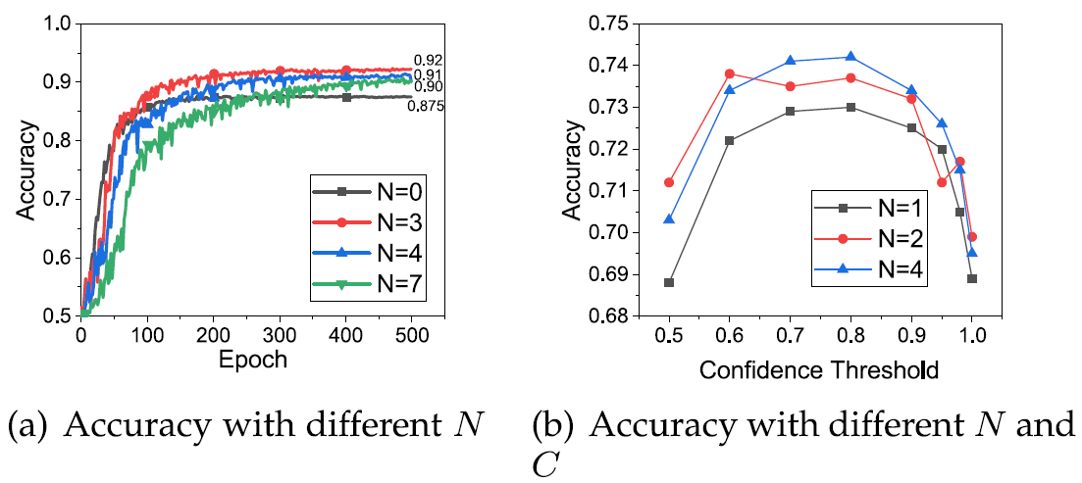
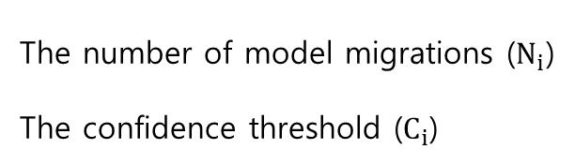
Introduction – Optimization Variables
The number of model migrations ($N_{i}$)
The confidence threshold ($C_{i}$)
<Effect of different numbers of model migrations $N$ and thresholds $C$ on the test accuracy.>

Slide 10
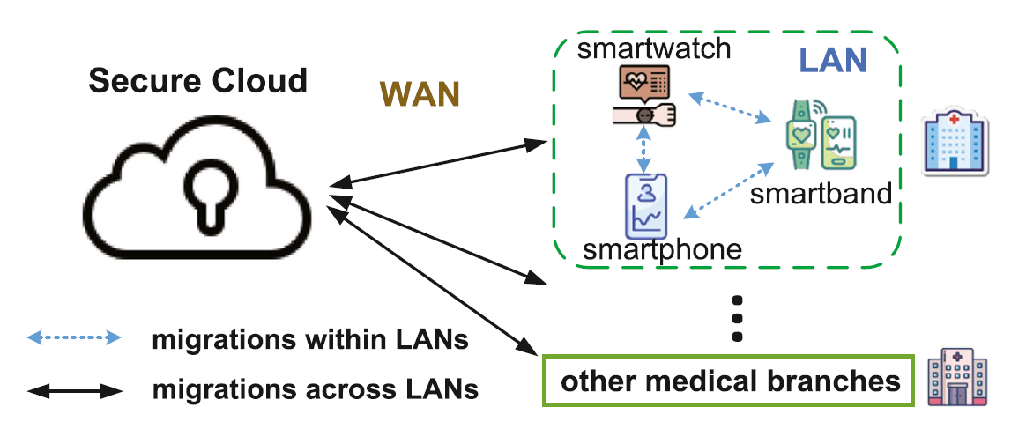
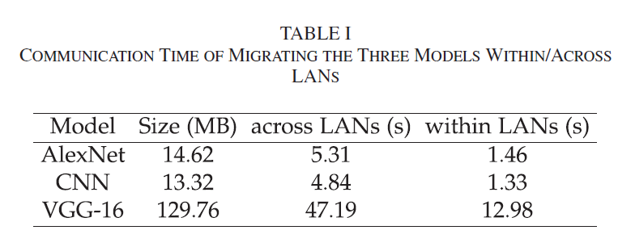
Introduction – Optimization Variables
The number of model migrations ($N_{i}$)
The confidence threshold ($C_{i}$)
<LAN-aware model migrations in the healthcare system.>

Slide 11
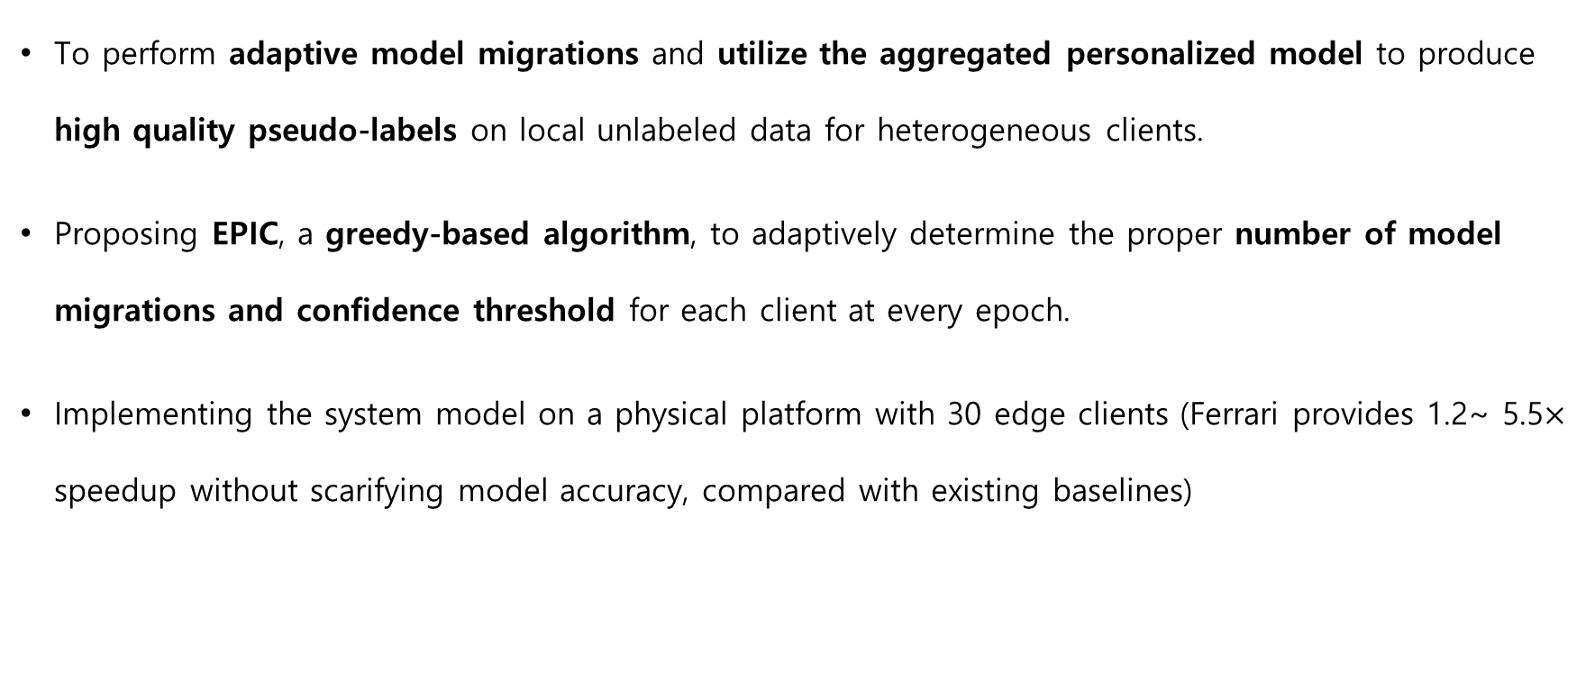
Introduction - Contributions
To perform adaptive model migrations and utilize the aggregated personalized model to produce high quality pseudo-labels on local unlabeled data for heterogeneous clients.
Proposing EPIC, a greedy-based algorithm, to adaptively determine the proper number of model migrations and confidence threshold for each client at every epoch.
Implementing the system model on a physical platform with 30 edge clients (Ferrari provides 1.2~ 5.5$×$ speedup without scarifying model accuracy, compared with existing baselines)

Slide 12
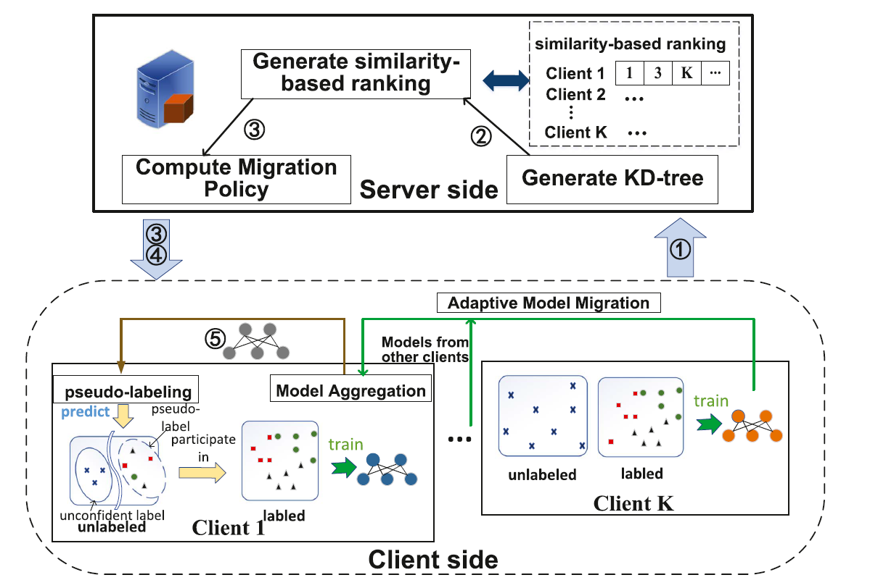
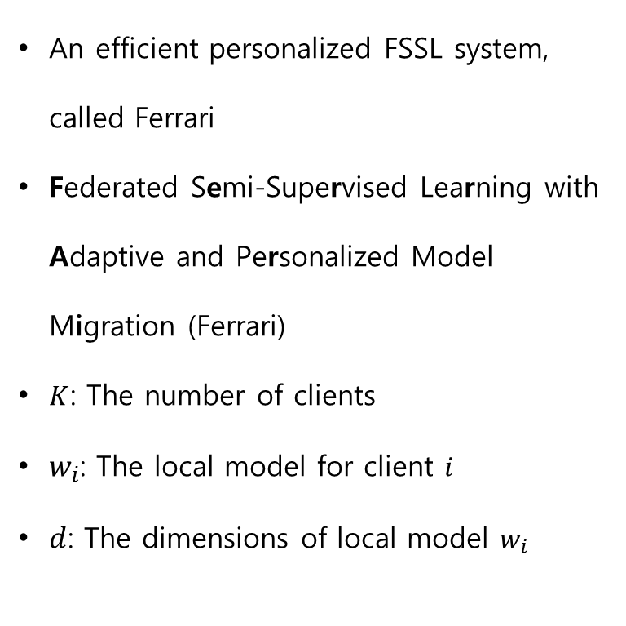
System model
An efficient personalized FSSL system, called Ferrari
Federated Semi-Supervised Learning with Adaptive and Personalized Model Migration (Ferrari)
$K$: The number of clients
$w_{i}$: The local model for client $i$
$d$: The dimensions of local model $w_{i}$
<System Overview>

Slide 13
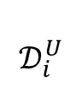
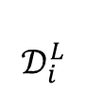
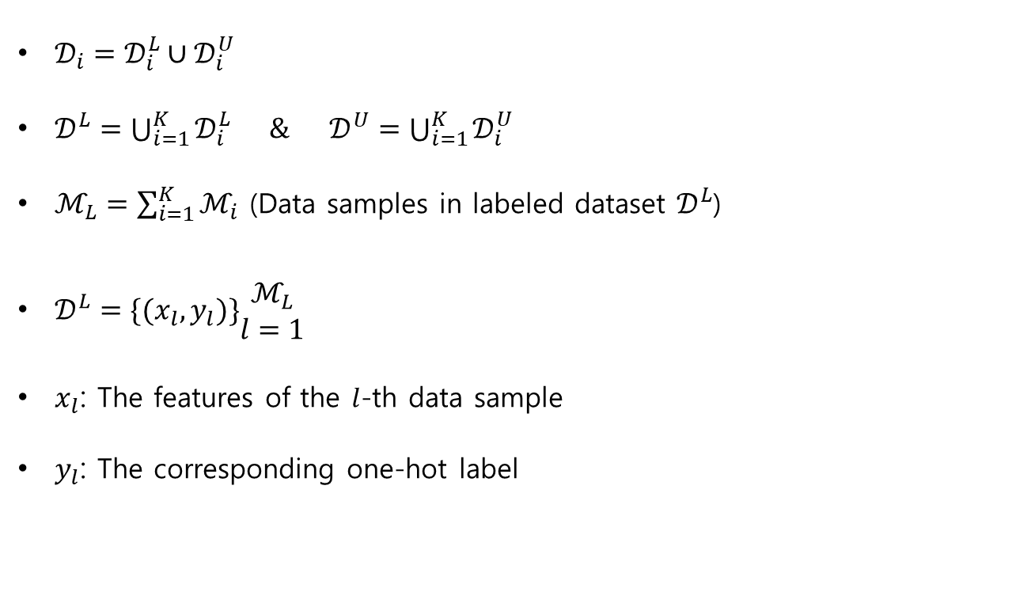
Problem Formulation
$𝒟_{i}=𝒟_{i}^{L}∪𝒟_{i}^{U}$
$𝒟^{L}=\bigcup_{i=1}^{K}{𝒟_{i}^{L}} \& 𝒟^{U}=\bigcup_{i=1}^{K}{𝒟_{i}^{U}}$
$ℳ_{L}=\sum_{i=1}^{K}{ℳ_{i}}$ (Data samples in labeled dataset $𝒟^{L}$)
$𝒟^{L}=\{(x_{l},y_{l})\}\begin{matrix}ℳ_{L} \\ l=1\end{matrix}$
$x_{l}$: The features of the $l$-th data sample
$y_{l}$: The corresponding one-hot label
$$𝒟_{i}^{U}$$
$$𝒟_{i}^{L}$$

Slide 14
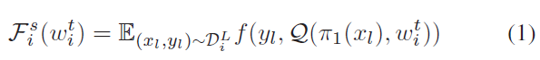
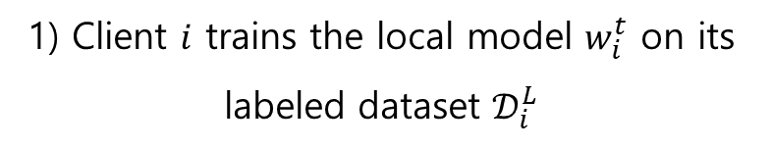
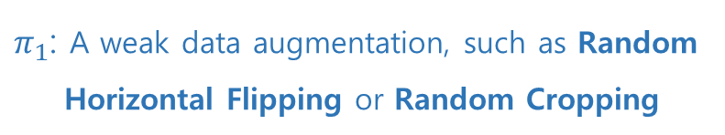
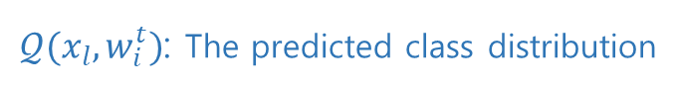
Sequence Diagram
Client
1) Client $i$ trains the local model $w_{i}^{t}$ on its labeled dataset $𝒟_{i}^{L}$
$𝒬(x_{l}, w_{i}^{t})$: The predicted class distribution
The supervised loss function: (cross-entropy loss)
$π_{1}$: A weak data augmentation, such as Random
Horizontal Flipping or Random Cropping

Slide 15
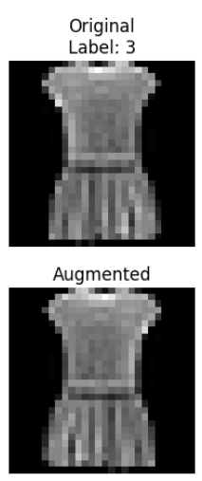
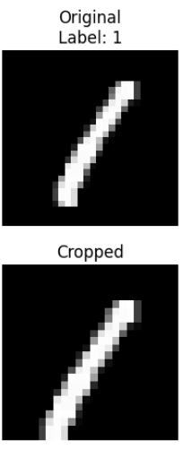
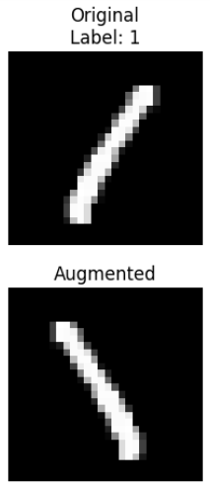
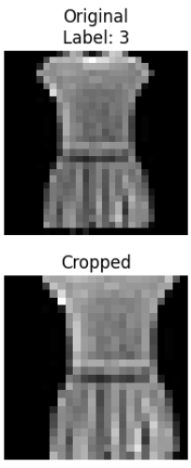
Data Augmentation Methods: Random Horizontal Flipping & Random Cropping
Random Horizontal Flipping
Random Cropping
Artificially expand the size and diversity of a dataset
Introduce variability and improve the robustness of models
Flip an image horizontally (left-to-right) with a specified probability (often 50%)
Randomly selecting a rectangular region from the original image and resizing it (if necessary) to match the desired dimensions.
If the image is flipped, the pixels on the left side are swapped with the corresponding pixels on the right side, creating a mirror image along the vertical axis.

Slide 16
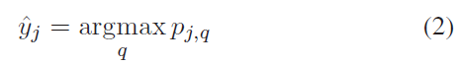
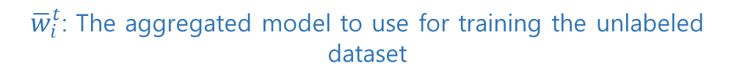
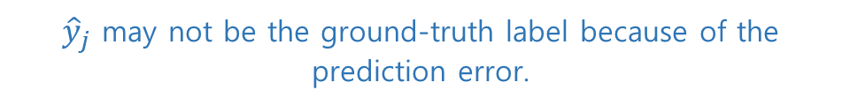
Sequence Diagram
Client
1) Client $i$ trains the local model $w_{i}^{t}$ on its labeled dataset $𝒟_{i}^{L}$
2) Client $i$ makes labels on its unlabeled dataset $𝒟_{i}^{U}$
$𝒬(x_{l}, w_{i}^{t})$: The predicted class distribution
${\hat{y}}_{j}$ may not be the ground-truth label because of the prediction error.
The supervised loss function: (cross-entropy loss)
The consistency loss:
$π_{1}$: A weak data augmentation, such as Random
Horizontal Flipping or Random Cropping
${\overline{w}}_{i}^{t}$: The aggregated model to use for training the unlabeled dataset
$π_{2}$: A strong data augmentation, such as RandAugment

Slide 17
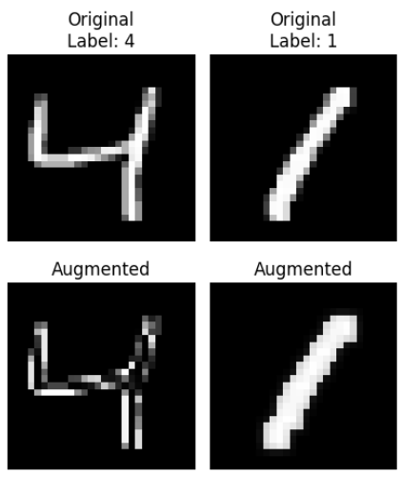
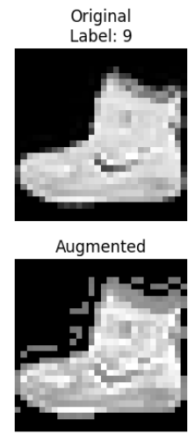
Data Augmentation Method (strong): RandAugment
It automates the process of selecting and applying data augmentation techniques by introducing randomness and simplicity.
Two hyper-parameters:
$N$: The number of augmentation transformations to apply.
$M$: The magnitude or intensity of these transformations.

Slide 18
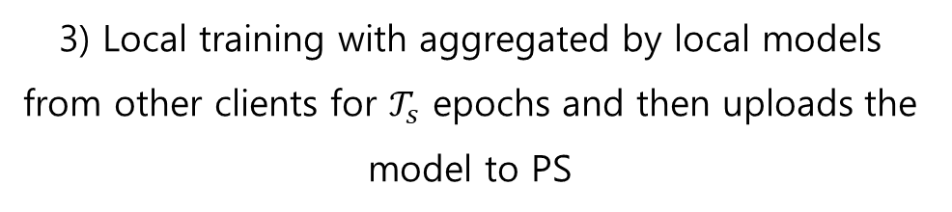
Sequence Diagram
Client
PS
3) Local training with aggregated by local models from other clients for $𝒯_{s}$ epochs and then uploads the model to PS
1) Client $i$ trains the local model $w_{i}^{t}$ on its labeled dataset $𝒟_{i}^{L}$
2) Client $i$ makes labels on its unlabeled dataset $𝒟_{i}^{U}$
4) Collects all local models
$𝒬(x_{l}, w_{i}^{t})$: The predicted class distribution
${\hat{y}}_{j}$ may not be the ground-truth label because of the prediction error.
5) Computes the similarity-based ranking using Gaussian K-Dimensional (KD)-Tree
The supervised loss function: (cross-entropy loss)
The consistency loss:
6) Generates the migration policy and broadcast among clients
7) Training using the new migration policy and do process until reaching the convergence
$π_{1}$: A weak data augmentation, such as Random
Horizontal Flipping or Random Cropping
${\overline{w}}_{i}^{t}$: The aggregated model to use for training the unlabeled dataset
$π_{2}$: A strong data augmentation, such as RandAugment

Slide 19
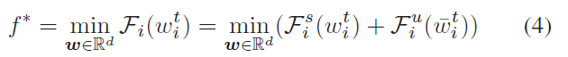
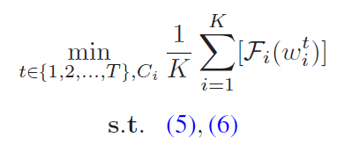
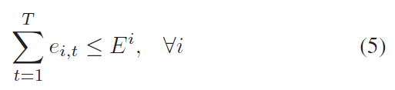
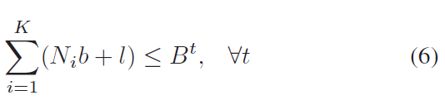
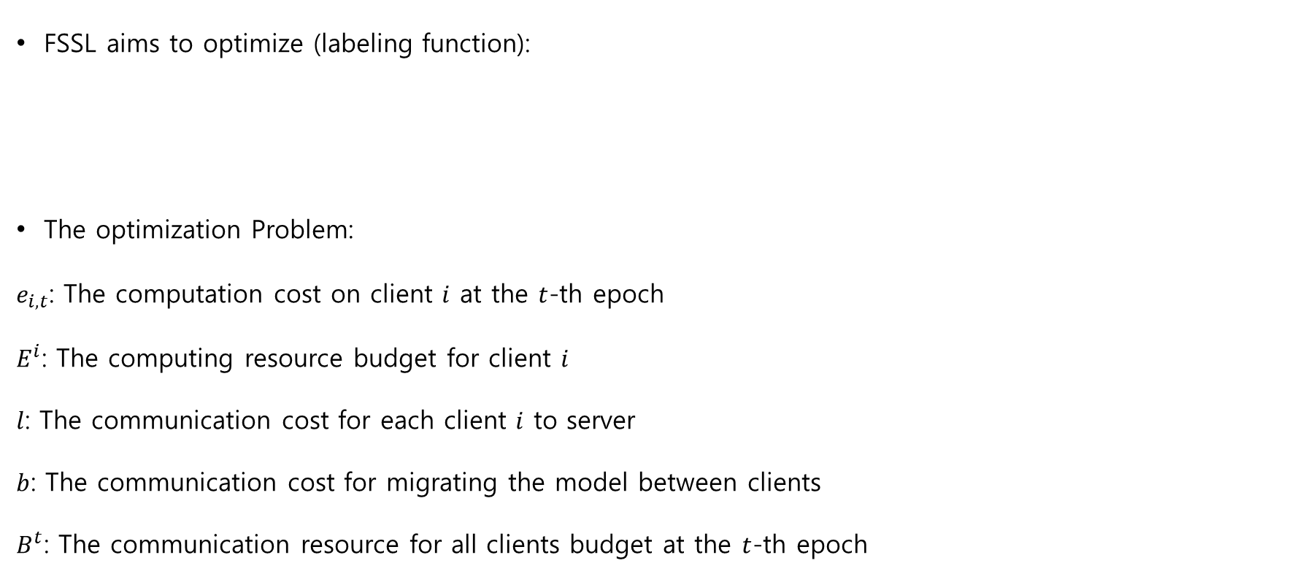
Problem Formulation
FSSL aims to optimize (labeling function):
The optimization Problem:
$e_{i, t}$: The computation cost on client $i$ at the $t$-th epoch
$E^{i}$: The computing resource budget for client $i$
$l$: The communication cost for each client $i$ to server
$b$: The communication cost for migrating the model between clients
$B^{t}$: The communication resource for all clients budget at the $t$-th epoch
To solve the optimization problem using a greedy-based algorithm EPIC

Slide 20
Problem Formulation
Energy-efficient Privacy-preserving Intelligent Communication (EPIC)
Advantages of Greedy EPIC Algorithm:
Simplicity: Computationally less expensive compared to exhaustive search.
Scalability: Works well with large-scale systems where global optimization is computationally infeasible.
Practicality: Easily implementable in real-world systems.
Challenges:
Local Optima: May get stuck in suboptimal solutions.
Trade-offs: Requires careful design of the utility function to balance energy, privacy, and communication efficiency.
A. Alsharif, M. Nabil, S. Tonyali, H. Mohammed, M. Mahmoud, and K. Akkaya, “EPIC: Efficient privacy-preserving scheme with EtoE data integrity and authenticity for AMI networks,” IEEE Internet of Things Journal, 6(2), 3309-3321, 2018.

Slide 21
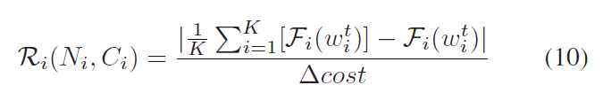
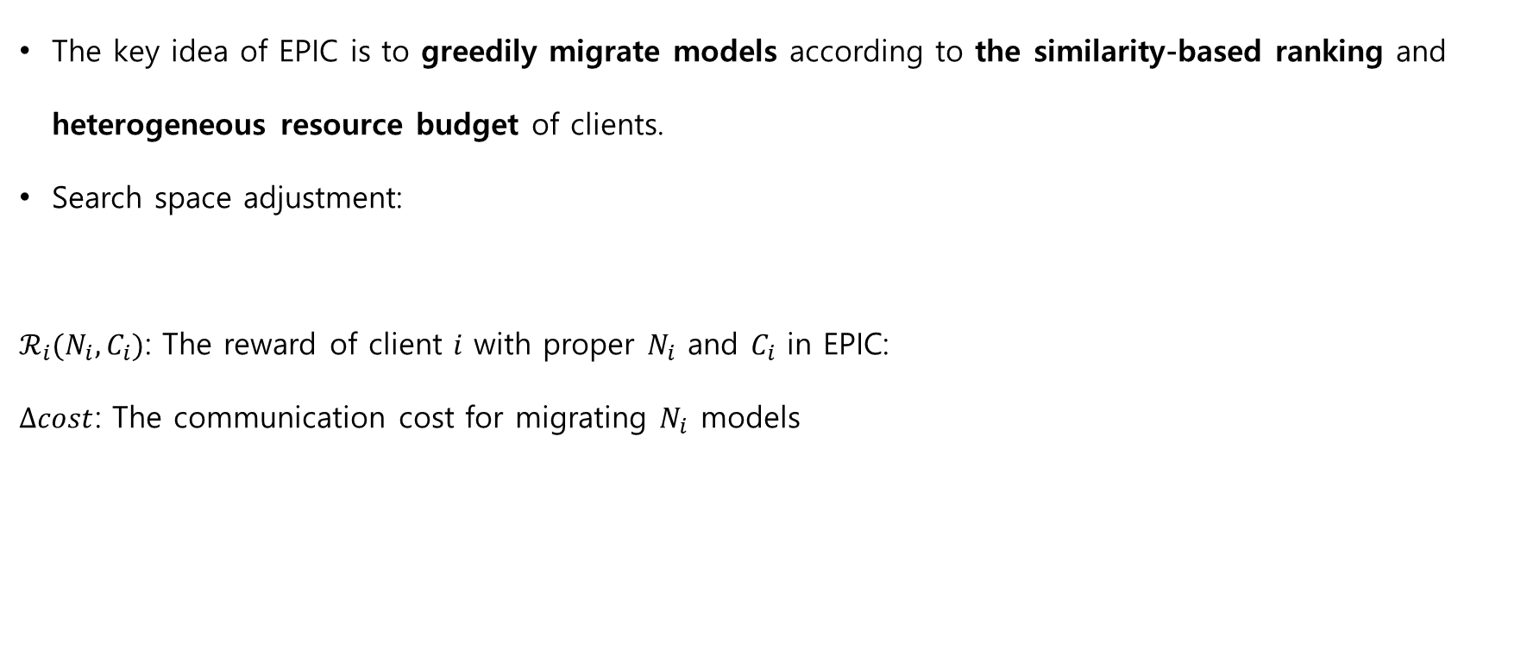
Problem Formulation
The key idea of EPIC is to greedily migrate models according to the similarity-based ranking and heterogeneous resource budget of clients.
Search space adjustment:
$ℛ_{i}(N_{i},C_{i})$: The reward of client $i$ with proper $N_{i}$ and $C_{i}$ in EPIC:
$∆cost$: The communication cost for migrating $N_{i}$ models

Slide 22
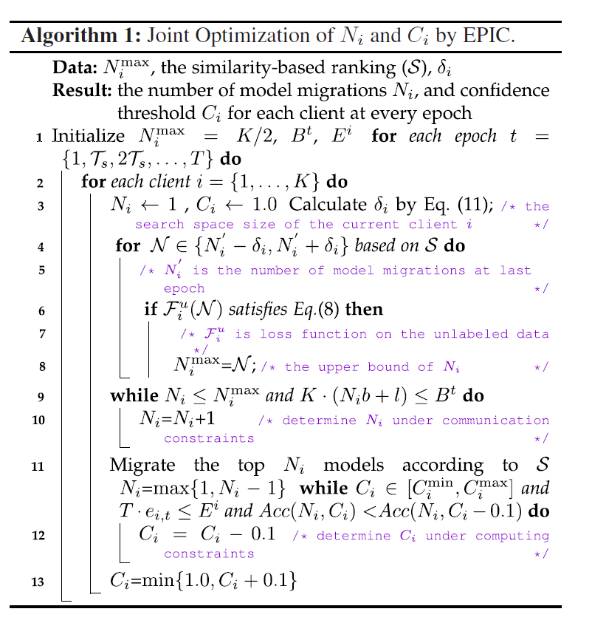
Algorithm

Slide 23
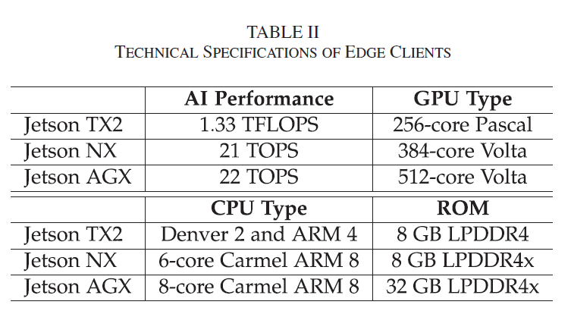
Performance Evaluation
System Implementation:
Parameter Server:
Intel(R) Core(TM) i9-10900X CPU
4 NVIDIA GeForce RTX 2080Ti GPUs
128 GB RAM
Clients (30):
10 NVIDIA Jetson TX2
10 NVIDIA Jetson Xavier
10 NVIDIA Jetson AGX

Slide 24
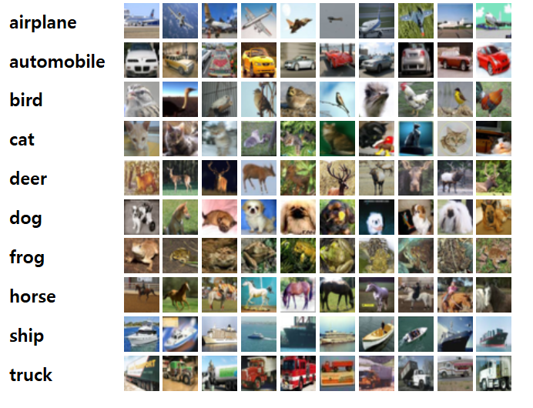
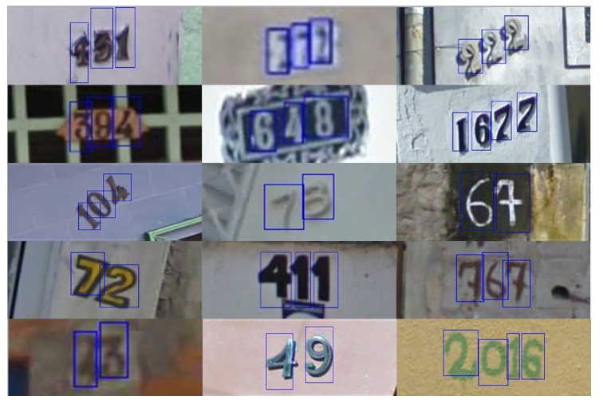
Performance Evaluation
Datasets:
CIFAR-10, SVHN (10 Classes), and Human Action Recognition (HAR)
CIFAR-10 (AlexNet):
Train dataset: 10,000 Labeled + 40,000 Unlabeled
Test dataset: 10,000
SVHN (CNN):
Train dataset: 50,225 (ratio 0.8 unlabeled)
Test dataset: 26,032
HAR (CNN):
6 activities: Sitting, Standing, Laying Down, Walking, Walking Downstairs, Walking Upstairs

Slide 25
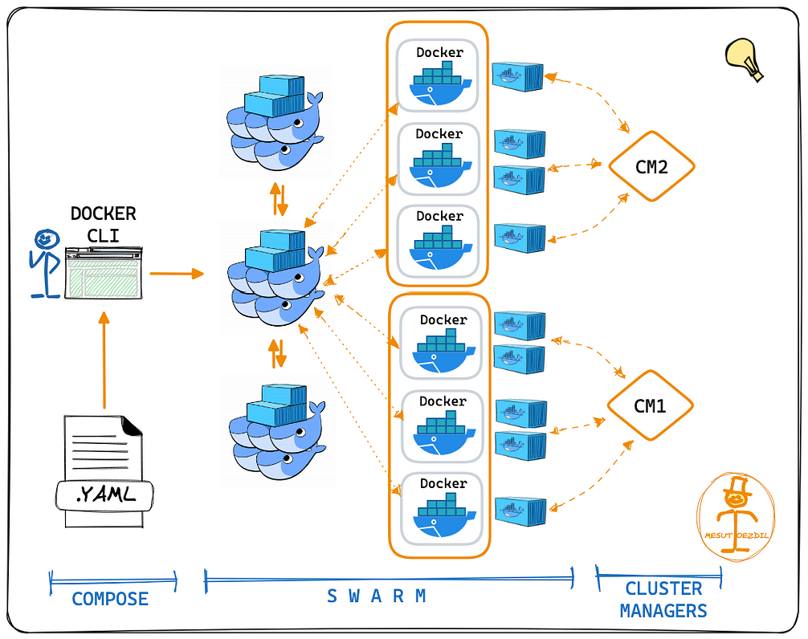
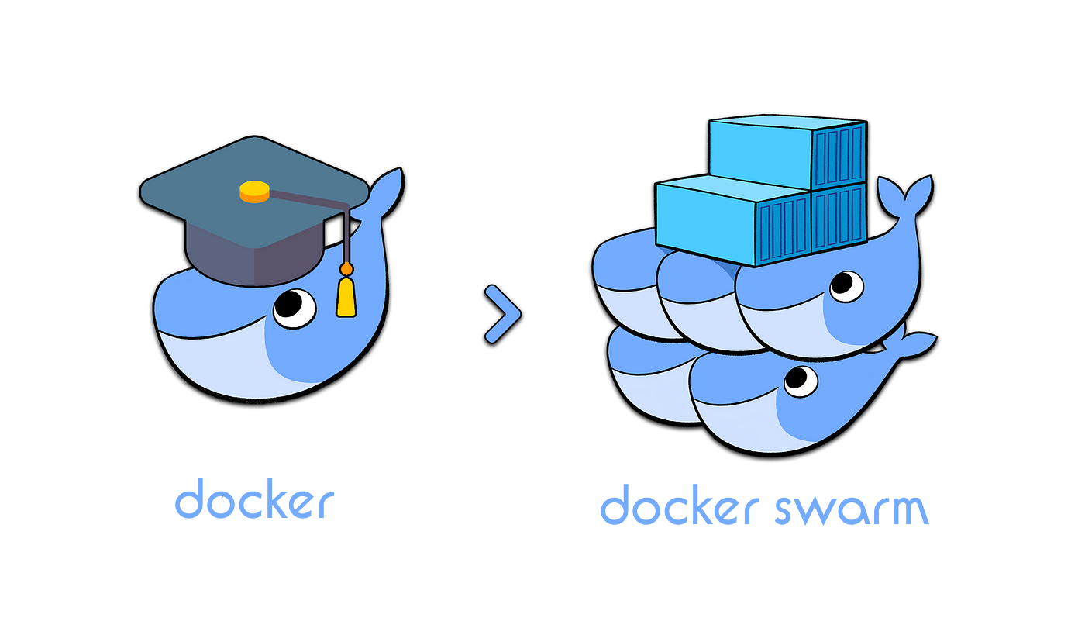
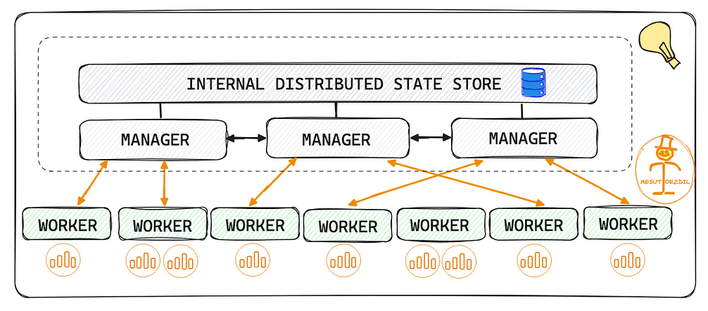
Performance Evaluation
Using the Docker swarm

Slide 26
Performance Evaluation
Baselines:
FedAvg
Uses labeled data for training and averages model updates from clients.
Does not account for heterogeneity or knowledge sharing among clients.
pFedMe
Allows clients to update local models independently without diverging far from a global reference model.
Supports training on both labeled and unlabeled data.
UM-pFSSL
Enables clients to share knowledge by migrating fixed numbers of models across clients.
Lacks dynamic optimization for migration and does not explore confidence thresholds for pseudo-labeling.

Slide 27
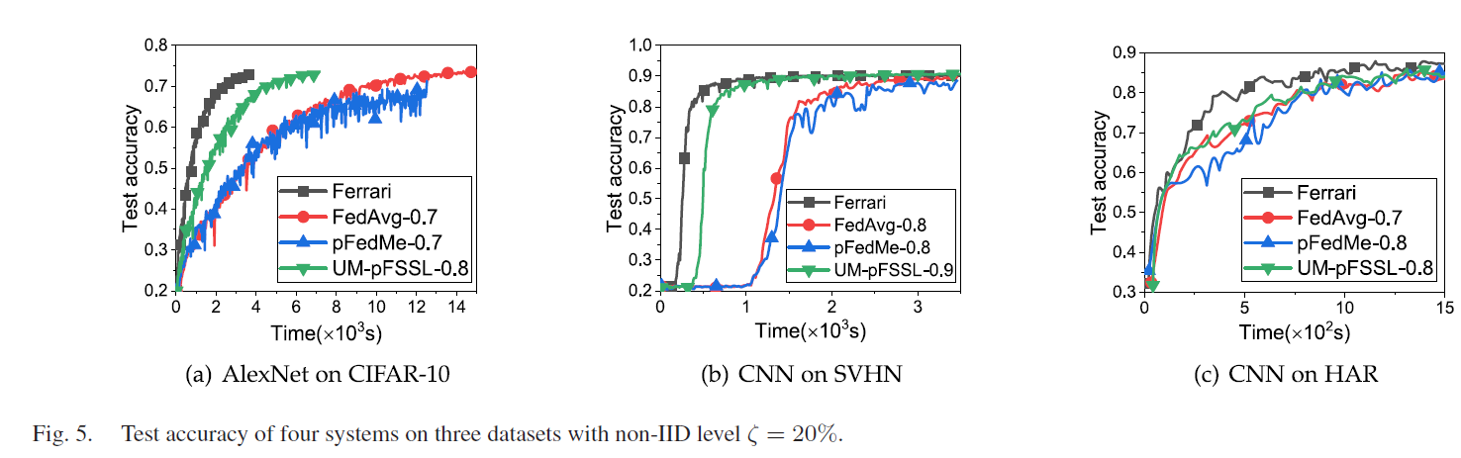
Performance Evaluation
AlexNet on CIFAR-10
CNN on SVHN
CNN an HAR
Convergence speed:
Ferrari has the fastest convergence

Slide 28
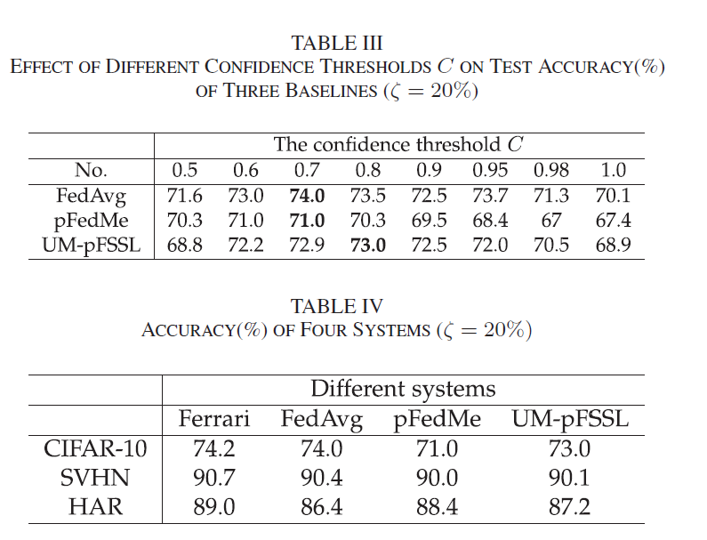
Performance Evaluation

Slide 29
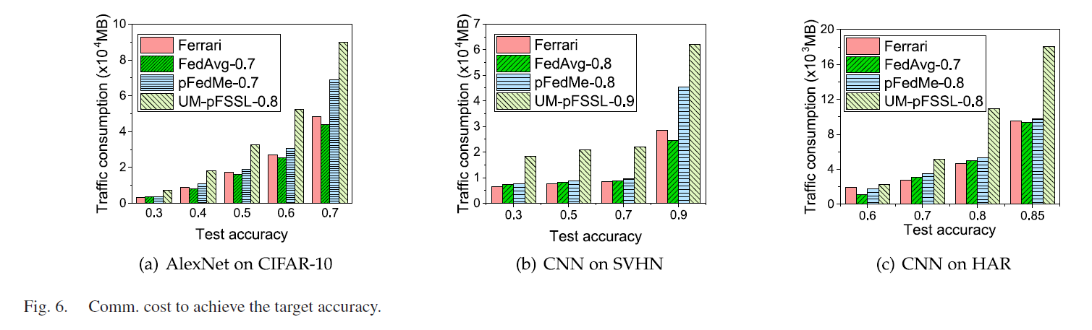
Performance Evaluation
Communication cost:
Ferrari achieves higher accuracy with less communication cost
Effect of adaptive model mitigation within LANs

Slide 30
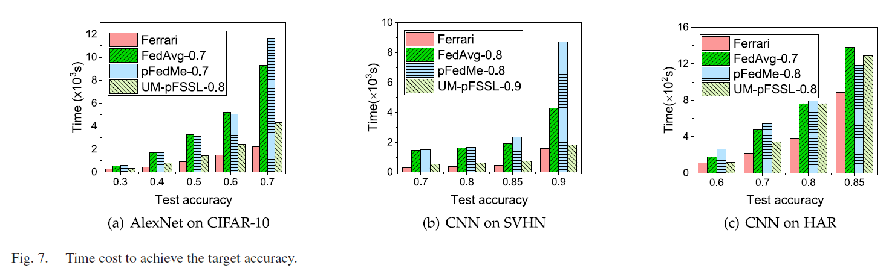
Performance Evaluation
Ferrari has the fastest convergence

Slide 31
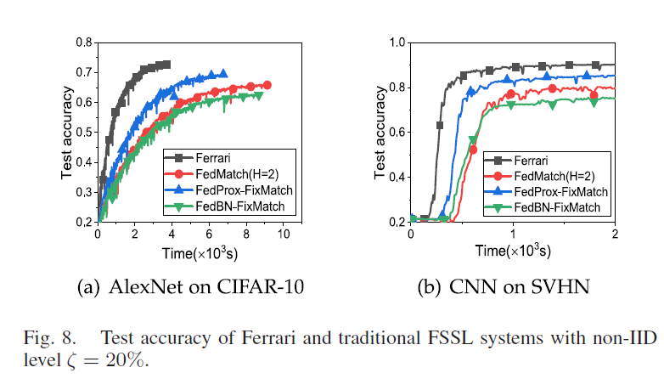
Performance Evaluation
pFSSL v.s Traditional FSSL:
H=2 → The selection of two helper agents for each client at each epoch.
In FedMatch, the migration number is fixed without considering the impact of confidence threshold.

Slide 32
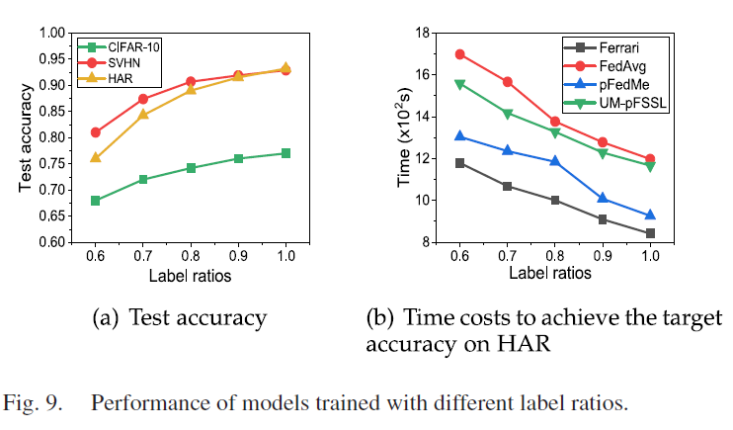
Performance Evaluation
Effect of different label ratios:

Slide 33
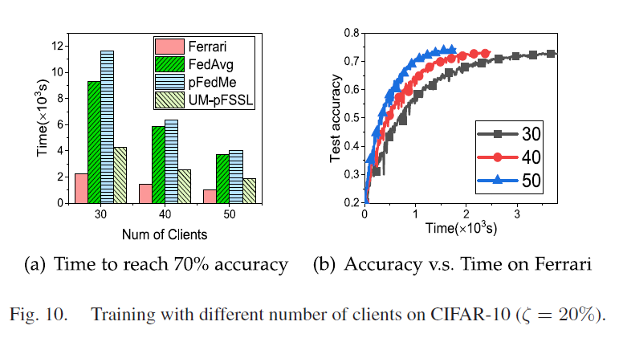
Performance Evaluation
Effect of system scales:
By increasing the number of clients, the model convergence in all systems becomes faster because of more training data generated by clients.

Slide 34
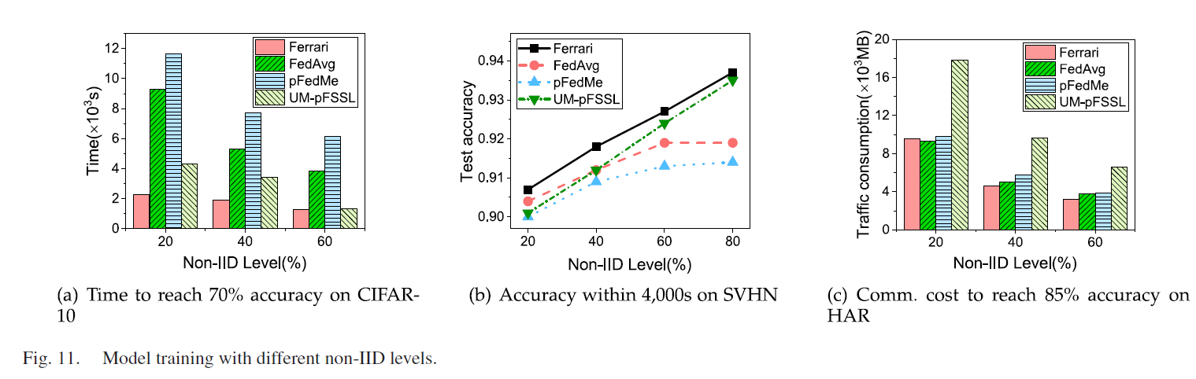
Performance Evaluation
Impact of data distributions (non-IID data on training performance):

Slide 35
Conclusions
Presented the designed and implementation of novel FSSL called Ferrari, to accelerate model training and boost the pseudo-labeling among clients under resource limitation and data heterogeneity.
Utilized model migrations within LANs to allow knowledge sharing among clients.
The trade-off between the quantity and the quality of pseudo-labels to enhance model performance with fewer communication resources (resources limitation and similar models’ potential).
Ferrari achieved with the number of model migrations and the confidence thresholds for heterogeneous clients during training.
Ferrari outperforms benchmarks on three world datasets and models without sacrificing model accuracy.

Slide 36
Thank you
faranak1995@gachon.ac.kr

Slide 37
Thank you
faranak1995@gachon.ac.kr

